Slide 1
Online Auction And Bidding System
Team no:14
Student Name: Shreyasi Roll No: 2620030164
Student Name: Harshini Roll No: 2620030649
Student Name: Neha Roll No: 2620030662

Slide 2
Abstract
An Online Auction and Bidding System is a digital platform where sellers list items or services and buyers compete for them in real time over the internet. The system has five main steps. First, users create verified accounts as buyers, sellers, or administrators. Sellers then post items with photos, descriptions, base prices, and auction end times. Buyers place real-time bids, and the system instantly updates the highest price. When the countdown ends, the highest bidder automatically wins, and the platform processes the final transaction through online payment.
The system benefits users by allowing them to bid from anywhere in the world, providing real-time updates and tracking for fair bidding. Sellers can also reach buyers worldwide. The system mainly has three types of users: admin, seller, and buyer. The admin monitors the website, listed items, and transactions. Sellers can create accounts, upload product details and photos, set starting prices, and control the auction duration. Buyers can create accounts, view available items, and bid on products they like.
The system saves time and makes buying and selling easier and more convenient. Future improvements may include AI-based fraud detection and enhanced security, making the platform safer, fairer, and more effective for online transactions.

Slide 3
Understanding Problem Statement
The Problem
Traditional auctions require physical presence at a specific location and time
Limited participation due to geographical and temporal constraints
Inconvenient for both buyers and sellers
Proposed Solution
An Online Auction and Bidding System enables digital participation anytime, anywhere — eliminating barriers and expanding reach.
Objectives
Enable sellers to list products with full details
Allow buyers to place competitive bids remotely
Track and update the highest bid automatically
Identify the winning bidder systematically
Apply Java programming to a real-world problem

Slide 4
CO 1: Java Foundations & Problem Solving
Problem Decomposition
Product Listing Management
Bid Placement & Validation
Highest-Bid Calculation & Winner Declaration
Java Concepts Applied
Data Types
int, double, String — for product info and bid amounts
Operators
Relational > for bid comparison; arithmetic for calculations
Scanner Input
Accept user input for bids, product names, and details

Slide 5
Co 2: Control Flow
if-else Statements
Validate bid amount and user role. Nested if checks auction status and bid eligibility before acceptance.
switch Statement
Routes navigation to Admin, Seller, or Buyer menu based on user selection.
Loops
while: Keep auction running until end time
for: Display all products or bidding history
break/continue: Control bid acceptance and auction flow

Slide 6
CO 3: Methods, Arrays & Data Organization
Arrays for Data Storage
1D Arrays
Modular Methods
addProduct()
Seller adds a new product to the system
displayProducts()
Show all available products to buyers
placeBid()
Accept and validate buyer bid input
declareWinner()
Identify the highest bidder at auction end

Slide 7
CO 4: Object-Oriented Modelling, Design & Exception Handling
Classes & Objects
Classes as blueprints; objects as instances
Fields, methods & object creation using new
Constructors: default, parameterized & overloading
this, null & reference concepts
Encapsulation: private fields, accessors & mutators
Inheritance & Interfaces
is-a relationships and method overriding
Programming to interfaces
Exception Handling
Checked vs unchecked exceptions
try-catch, throw & throws

Slide 8
CO 5: Strings, Library Algorithms & File I/O
String Abstraction
Immutability
concatenation
equals() vs == for value/reference comparison
StringBuilder & StringBuffer
split(), join(), trim() & validation
Library Algorithms & File I/O
Arrays.sort()
Comparable & Comparator
Path & Files APIs
Read complete files or process line-by-line
Handle missing/malformed records

Slide 9
CO 6: Functional Programming with Collections & Streams
Collections Framework
List
ArrayList
Generics & type safety
Autoboxing & collection iteration
Lambdas & Stream Pipelines
Predicate, Consumer
Filter
forEach, count

Slide 10
Conclusion
The Online Auction and Bidding System provides a convenient, efficient, and user-friendly platform for buying and selling products online. By using Java programming concepts such as control flow, methods, arrays, object-oriented programming, exception handling, collections, and file handling, the system simplifies product listing, bid management, and winner declaration. It reduces the limitations of traditional auctions by enabling users to participate from anywhere. In the future, the system can be enhanced with AI-based fraud detection, improved security, and secure online payment integration to make online auctions more reliable, transparent, and efficient.

Slide 11
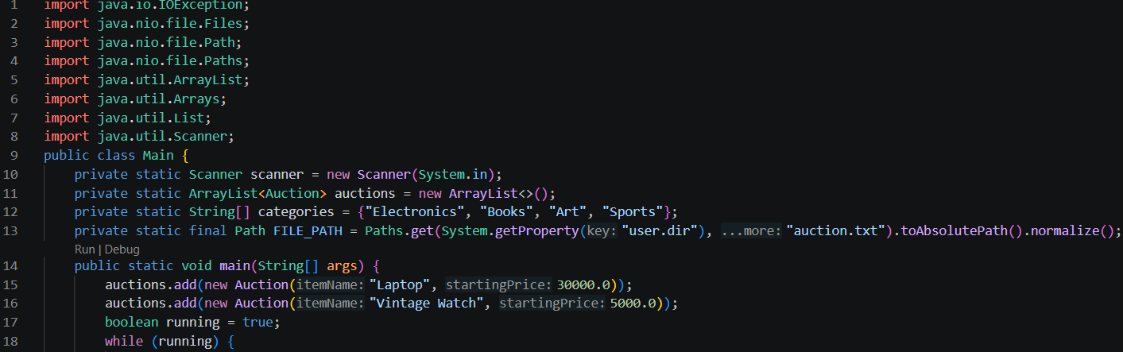
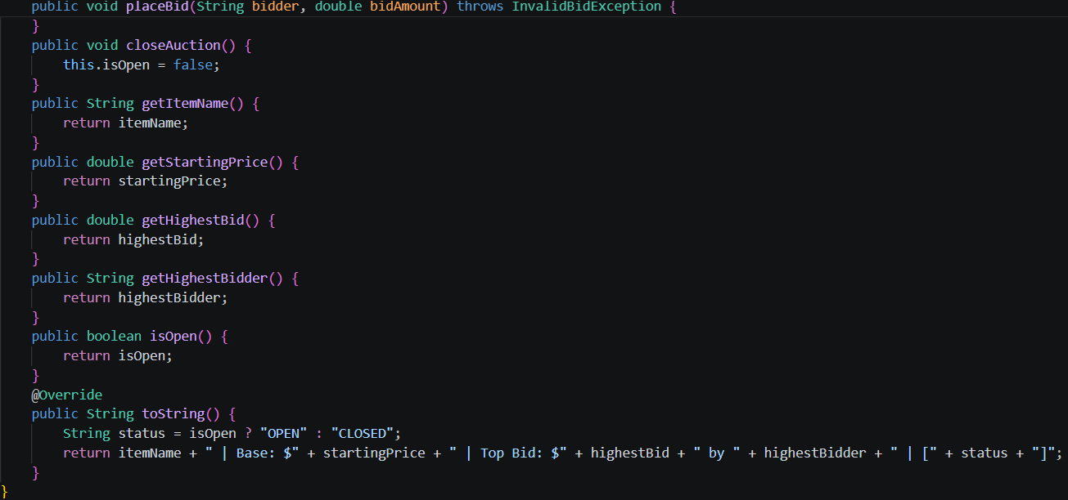
Screenshots

Slide 12
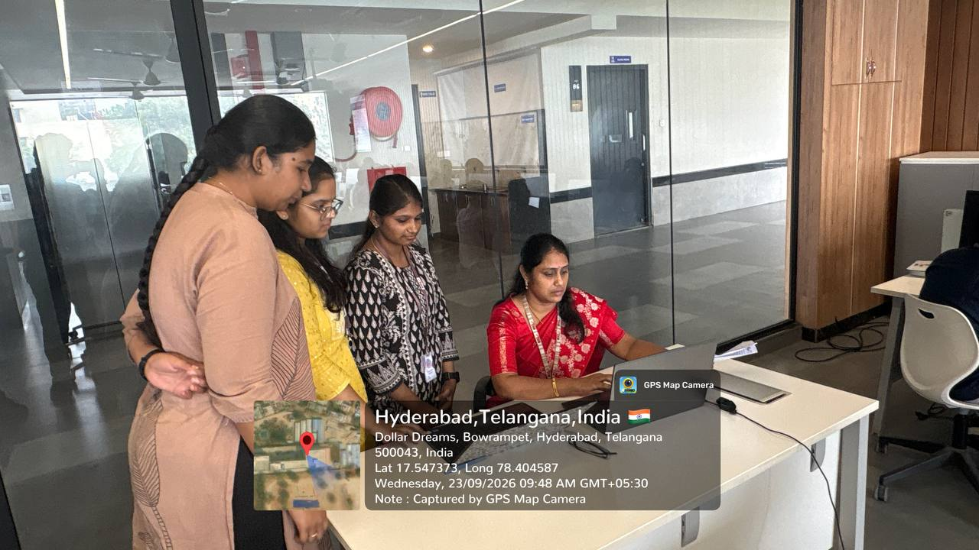
Geo Tag Photo and git hub link
https://github.com/shreyasi38355-jpg
https://github.com/harshinimharshinim387-boop
https://github.com/nehalinga-2008

